Slide 1
Distributed Database Systems
Autumn, 2017
Chapter 12 – Part 1 of 3
Distributed DBMS Reliability
Distributed Database Systems

Slide 2
12.1 Reliability Concepts And Measures
12.2 Failures And Fault Tolerance In
Distributed Systems
12.3 Failures In Distributed DBMS
  12.3.1 Transaction Failures
    Incorrect input data,
    The detection of deadlock, ….
  12.3.2 Site (System) Failures
  12.3.3 Media Failures
  12.3.4 Communication Failures
Distributed Database Systems

Slide 3
Local Reliability Protocols
Section 12.4
Distributed Database Systems

Slide 4
12.4 Local Reliability Protocols
LRM (Local Recovery Manager) maintain the atomicity and durability properties of local transactions by performing some functions.
Accepted commands
  begin_transaction
  read / write
  commit / abort
Distributed Database Systems

Slide 5
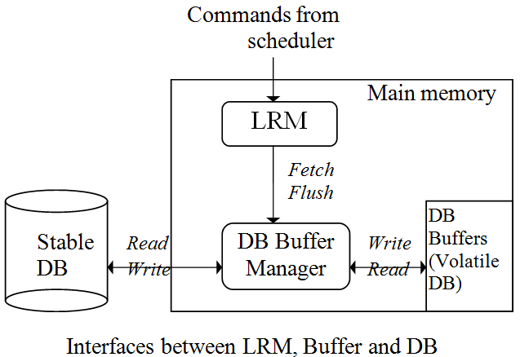
12.4.1 Architectural Considerations
LRM executes operations only on the volatile DB.
Buffers are organized in pages
Distributed Database Systems

Slide 6
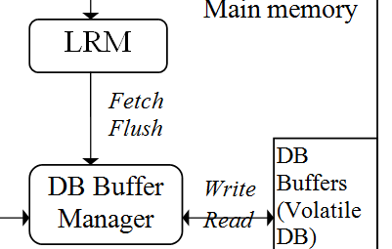
12.4.1 Architectural Considerations
Fetch
  Get a page.
  If the page is in DB buffers then the Buffer Manager returns it; otherwise the buffer Manager reads it from the Stable DB and puts it in buffers. An algorithm is needed if the buffer is full.
Flush
  Write pages.
  Force pages to be written from buffers to the stable DB.
Distributed Database Systems

Slide 7
12.4.2 Recovery Information
In-place update
Physically change the value of data items in stable DB. The previous values are lost.
Out-of-place update
Do not change the value of data items in stable DB but maintain the new value separately.
Most DBMS use in-place update for better performance.
Distributed Database Systems

Slide 8
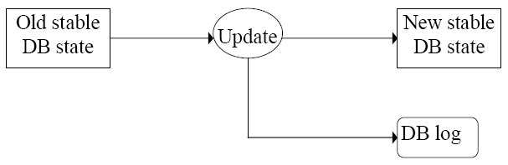
In-place update recovery information
Recovery information are kept in DB log. Each update not only changes DB, but also saves records in DB log.
Distributed Database Systems

Slide 9
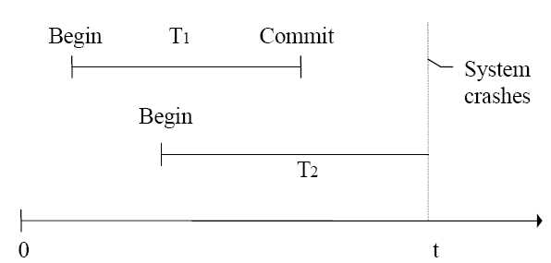
An example of system failure
Assume buffer pages are written back to the stable DB only when Buffer Manager needs new buffer space.
Distributed Database Systems

Slide 10
An example of system failure
T1: from user’s point of view it is committed. But updated buffer pages may get lost.
Distributed Database Systems

Slide 11
An example of system failure
T2: not terminated, but some updated pages may have been written to the stable DB. Undo is needed.
Distributed Database Systems

Slide 12
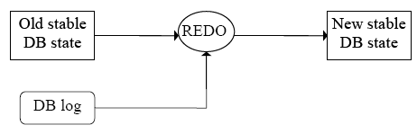
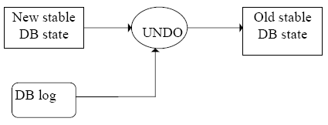
An example of system failure
Redo T1
Undo T2
Distributed Database Systems

Slide 13
An example of system failure
Both REDO and UNDO are idempotent.
Contents of DB log – transaction ID, begin/end of transaction, before image, after image, etc.
Distributed Database Systems

Slide 14
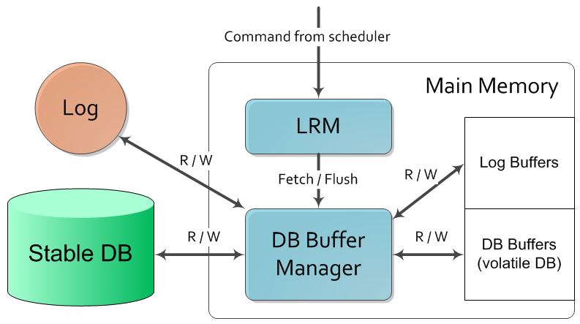
Log file maintenance
Interfaces between LRM, Buffer and DB and Log file
Distributed Database Systems

Slide 15
Log file maintenance
Two ways to write log pages
  Synchronous (forcing a log) – the adding of each log record requires that the log be moved from main memory to the stable storage.
  Asynchronous – the log is moved to stable storage either periodically or when the buffer fills up.
It's relative easy to recover to a consistent state, but causes delay to the response time.
Distributed Database Systems

Slide 16
Log file maintenance
Write-ahead logging (WAL) protocol
  Before the stable DB is updated, the before image should be stored in the stable log. This facilitates UNDO.
  When a transaction commits, the after images have to be written in the stable log prior to the updating of the stable DB. This facilitates REDO.
Distributed Database Systems

Slide 17
Subsection 12.4.3
Execution of LRM commands

Slide 18
12.4.3 Execution of LRM commands
Commands to the LRM
  Begin_transaction
  Read
  Write
  Abort
  Commit
  Recover
Distributed Database Systems

Slide 19
Different interaction between LRM and BM
Execution time actions
  Fix – BM waits for LRM to instruct it to write updated buffer pages into stable storage.
  No-fix – BM writes updated buffer pages into stable storage during the execution of a transaction.
Distributed Database Systems

Slide 20
Different interaction between LRM and BM
Commit time action
  Flush – BM flushes buffer pages updated by a transaction at the end of that transaction.
  No-flush – BM flushes updated pages whenever it needs to according to BM's algorithms.
Distributed Database Systems

Slide 21
Different interaction between LRM and BM
Four alternative combinations
  no-fix/no-flush,
  no-fix/flush,
  fix/no-flush, and
  fix/flush
Distributed Database Systems

Slide 22
Implementation of commands
Begin_transaction
  bookkeeping functions
  LRM writes a begin_transaction record in the log. This write may be delayed until first write command to reduce I/O.
Distributed Database Systems

Slide 23
Implementation of commands
Read (a data item)
  LRM tries to read the data item from the buffer. If the data is not in the buffer, LRM issues a fetch command.
  LRM returns the data to scheduler.
Distributed Database Systems

Slide 24
Implementation of commands
Write (a data item)
  If the data is in buffer, then update it; otherwise issue a fetch command to bring the data to the buffer first and then update it.
  Record before image and after image in log.
  Inform the scheduler the write has been completed.
Distributed Database Systems

Slide 25
No-fix/no-flush

Slide 26
Implementation of commands
Abort (No-fix/no-flush)
  Concerned with one transaction.
  BM may have written the updated pages into the stable DB for that transaction. An UNDO is needed. LRM reads the log records for that specific transaction and replaces values of updated items in the volatile DB with their before images (transaction undo, or partial undo).
  The scheduler is informed the completion of abort.
  No UNDO is needed for stable DB. (Why?)
Distributed Database Systems

Slide 27
Implementation of commands
Commit (No-fix/no-flush)
  LRM writes an end_of_transaction record in the log.
  No other actions.
Distributed Database Systems

Slide 28
Implementation of commands
Recover (No-fix/no-flush)
  LRM goes to the beginning of log and redoes all operations of each transaction for which both begin_transaction and end_of_transaction records are found (partial redo).
  Undo all operations of each transaction for which only begin_transaction is found in the log (global undo).
Distributed Database Systems

Slide 29
No-fix/flush

Slide 30
Implementation of commands
Abort (No-fix/flush)
  Identical to the case of no-fix/no-flush.
Distributed Database Systems

Slide 31
Implementation of commands
Commit (No-fix/flush)
  LRM issues a flush command to BM and then places an end_of_transaction record in the log.
Distributed Database Systems

Slide 32
Implementation of commands
Recover (No-fix/flush)
  No REDO since all updated pages are flushed at commit time.
  Complete global undo.
Distributed Database Systems

Slide 33
Fix/no-flush
In this case, BM is not allowed to write any updated pages into stable DB until at least the commit point.
Any fetch command to the BM for a write operation is replaced by a fix command which fixes updated pages in the buffer.

Slide 34
Implementation of commands
Abort (Fix/no-flush)
  No special action since no updated pages have been written into the stable DB.
  Release fixed buffer pages by sending an unfix command to BM.
  Write an abort record in the log and inform the scheduler.
Distributed Database Systems

Slide 35
Implementation of commands
Commit (Fix/no-flush)
  LRM sends an unfix command to BM (unfixed pages can be written back into stable DB at the direction of BM).
  Place a commit record in the log.
  Inform the scheduler.
Distributed Database Systems

Slide 36
Implementation of commands
Recover (Fix/no-flush)
  No global undo.
  Redo those transactions that have committed but whose buffer pages may have not been written into the stable DB.
Distributed Database Systems

Slide 37
Fix/flush
In this case LRM forces BM to write updated buffer pages precisely at the commit point.

Slide 38
Implementation of commands
Abort (Fix/flush)
  Identical to fix/no-flush.
Distributed Database Systems

Slide 39
Implementation of commands
Commit (Fix/flush)
  Step 1. LRM sends an unfix commend to BM.
  Step 2. LRM sends a flush command to BM.
  Step 3. Place an end-of-transaction record in the log.
  These 3 steps must be in one atomic action (Bernstein etc. 1987).
Distributed Database Systems

Slide 40
Implementation of commands
Recover (Fix/flush)
  No action.
Distributed Database Systems

Slide 41
Subsection 12.4.4
Checkpoint

Slide 42
Why checkpoint
Avoid the search of entire log when recovery process is required.
Checkpoint is a mark point in the log where redo and undo can refer.
Distributed Database Systems

Slide 43
Checkpoint steps
Write a begin-checkpoint record in the log.
Collect the checkpoint data into the stable DB.
Write an end-of-checkpoint record in the log.
All steps are in one atomic action.
An implementation of step 2 is illustrated on next page.
Distributed Database Systems

Slide 44
Checkpoint steps
An implementation for actions in step 2
  First write the begin-checkpoint record in the log and stop accepting new transactions.
  Complete all active transactions and flush all updated pages,
  Write an end-of-checkpoint record in the log.
Distributed Database Systems

Slide 45
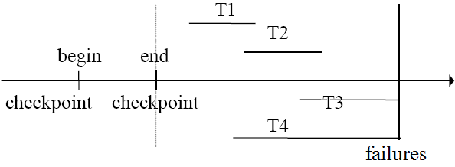
Recovery process based on checkpoint
Redo by starting from the end-of-checkpoint. The sequence is T1, T2. Stop at the end of log.
Undo by starting from the end-of-log and stopping at the end-of-checkpoint. The sequence is T3, T4.
Distributed Database Systems

Slide 46
To be continued…
Distributed Database Systems

